Slide 1
Sales Data Analysis & Insights
Name: Shivasri
Project: Data Analysis Task 4

Slide 2
Objective
The objective of this project is to analyze sales data to identify patterns and trends that influence business performance.
This analysis helps in understanding customer behavior and improving overall revenue.
Dataset Overview
The dataset contains sales transaction details including product category, price, quantity sold, and total revenue.
It provides valuable insights into product performance and customer purchasing patterns.

Slide 3
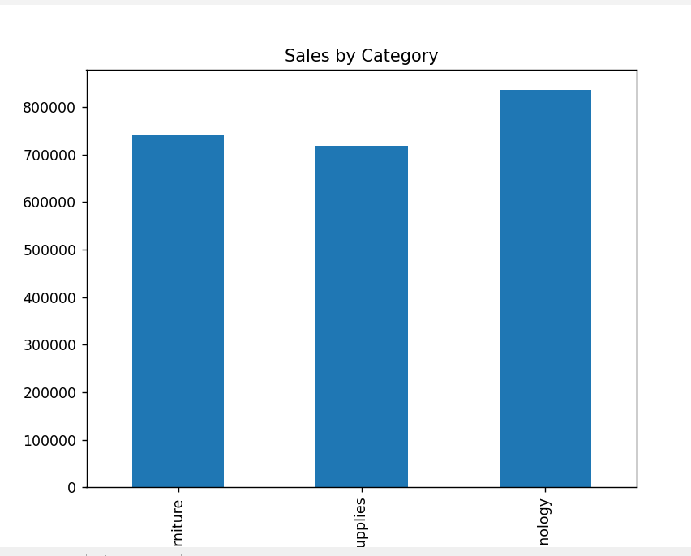
Key Insight 1 – Product Performance
The Electronics category generates the highest revenue among all product categories.
This indicates strong customer demand and higher profitability in this segment.

Slide 4
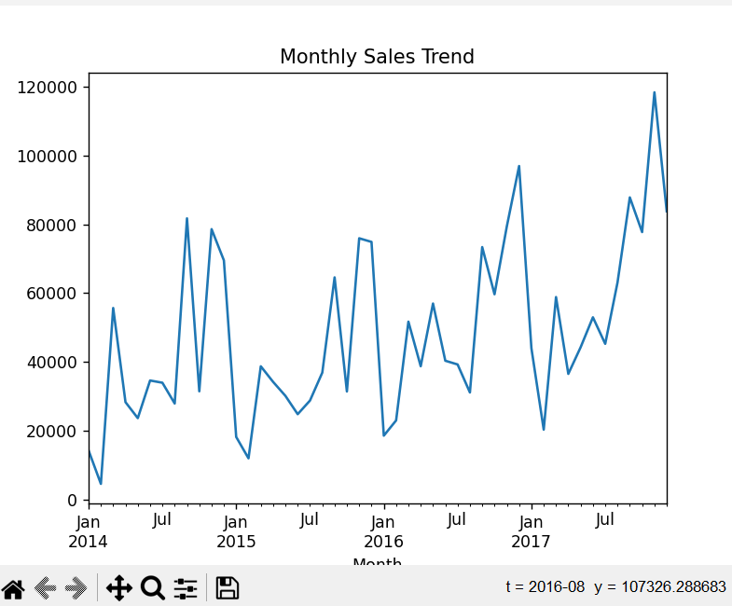
Key Insight 2 – Sales Trend
Sales are higher during weekends compared to weekdays.
This shows that customers are more active during weekends, making it an important time for promotions.

Slide 5
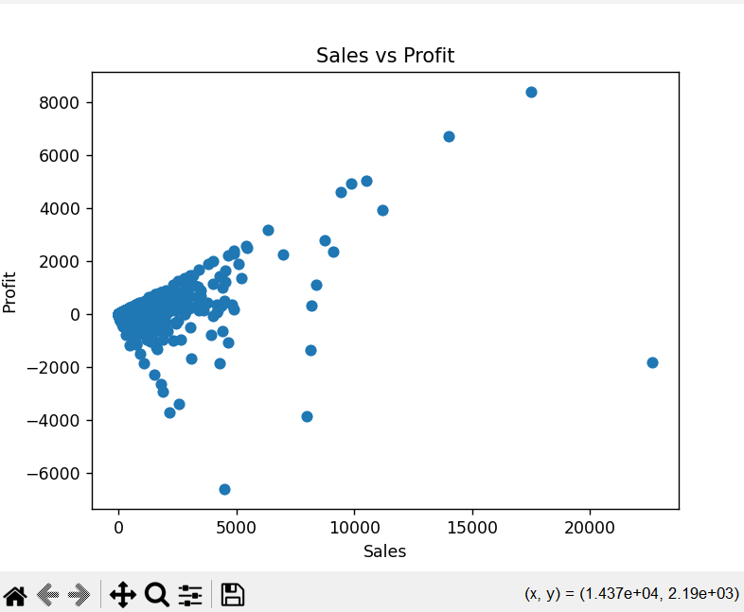
Key Insight 3 – Sales vs Profit
The scatter plot shows the relationship between sales and profit.
As sales increase, profit generally increases, although there are some fluctuations.

Slide 6
Business Impact
These insights help businesses:
Identify high-performing product categories
Optimize pricing strategies
Focus marketing efforts on peak sales periods
This can lead to improved sales and better decision-making.

Slide 7
Conclusion & Recommendations
Based on the analysis:
Focus on high-performing categories like Electronics
Increase promotions during weekends
Use competitive pricing strategies to attract more customers
These actions can significantly improve overall revenue.

Slide 8
Hypothesis Testing
Hypothesis: H₀: No significant difference in sales between categories H₁: Significant difference in sales between categories
Method Used: A T-test was performed using Python on the Superstore dataset.
Result: The p-value (0.00024) is less than 0.05, indicating statistical significance.
Conclusion: We reject the null hypothesis and conclude that sales differ significantly between categories.

